Slide 1
Conservative and non-Conservative Form
Conservative form of the governing equations in fluid mechanics is basically derived by using Eulerian approach while non-conservative form of the governing equations is derived by using Lagrangian approach.
Conservative and non-conservative forms are mathematically same but numerically different.
In conservative form, telescoping series effect occurs that is not present in non- conservative form.
Telescoping series: when you add up the terms over a grid, only the boundary terms should remain and the artificial interior points should cancel out.

Slide 2
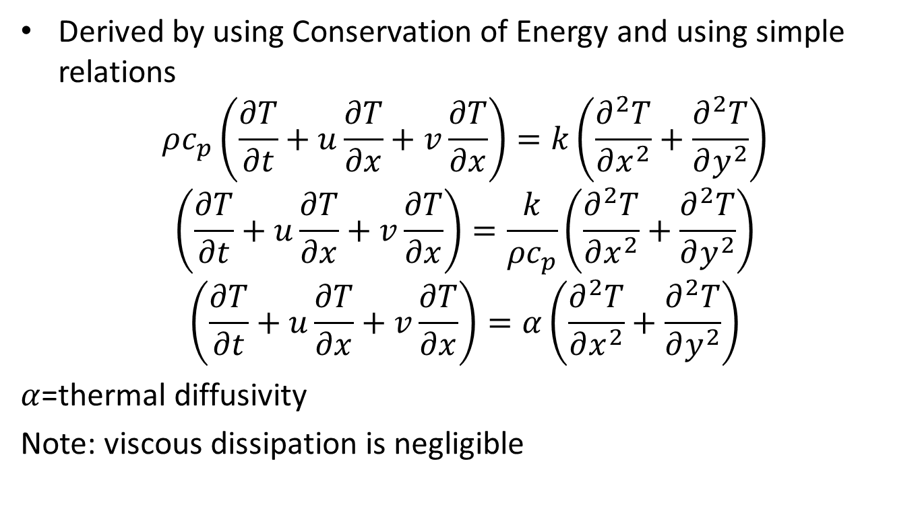
Thermal/Internal Energy Equation
Derived by using Conservation of Energy and using simple relations
$$ρc_{p}\left(\frac{∂T}{∂t}+u\frac{∂T}{∂x}+v\frac{∂T}{∂x}\right)=k\left(\frac{∂^{2}T}{∂x^{2}}+\frac{∂^{2}T}{∂y^{2}}\right)$$
$$\left(\frac{∂T}{∂t}+u\frac{∂T}{∂x}+v\frac{∂T}{∂x}\right)=\frac{k}{ρc_{p}}\left(\frac{∂^{2}T}{∂x^{2}}+\frac{∂^{2}T}{∂y^{2}}\right)$$
$$\left(\frac{∂T}{∂t}+u\frac{∂T}{∂x}+v\frac{∂T}{∂x}\right)=α\left(\frac{∂^{2}T}{∂x^{2}}+\frac{∂^{2}T}{∂y^{2}}\right)$$
$α$=thermal diffusivity
Note: viscous dissipation is negligible

Slide 3
What’s Happening Inside the lid Driven Cavity
Since top plate is moved towards right, causing shear effect and inducing forced convection inside the lid driven cavity.
At the bottom of the cavity, a heating source say heater is placed or the bottom surface is given certain temperature, then the fluid particles surrounding that heat source will become lighter because of the decrease in their density and will experience less buoyant force and therefore they will tend to move up while the particles away from the heat source will be relatively cold and denser experiencing large buoyant force and they will fall down because of gravity. Here the buoyancy effect is seen.
The phenomenon mentioned above is called mixed convection (Natural because of heated surface and forced Convection because of lid motion)
To incorporate the buoyancy effect in the algorithm and to compute the heat transfer because of convection, different approaches are used.

Slide 4
Contd.
Two of the most common approaches that are used to deal with this problem are:
Boussinesq Approximation
Lattice Boltzmann Method
Boussinesq Approximation is relatively simple than the lattice Boltzmann method, therefore I will use Boussinesq approximation.
A short introduction of Boussinesq approximation is mentioned in the next slide….

Slide 5
Boussinesq Approximation
Density variation is only considered in gravity term in Navier Stokes eq.
Density is assumed to be constant in all other terms.
Quiescent fluid is considered.
The momentum equation are altered by the induction of gravity term which incorporates the effect of buoyant force and the effect is included in the v component of velocity of the fluid particles.

Slide 6
Initial and Boundary Conditions
Quiescent Fluid is considered
At t = 0(initial),
u = 0, v = 0, P = 0.5 , T_top = 25 and T_bottom = 25
du/dx = 0, du/dy = 0 and dp/dy = 0
At t>0,
Top wall: u = 1; v=0; dP/dy=0; T_top= 25 ºC(let’s say):
Left Side Wall: u=0; v=0; dP/dx=0; dT/dx=0;(insulation):
Right Side Wall: u=0; v=0; dP/dx=0; dT/dx=0; (insulation):
Bottom Wall: u=0;v=0;dP/dy=0; T_bottom=75ºC(let’s say);
Note:
T_bottom > T_top ➔ density_bottom < density_top ➔ F_boyant @ dense Particles > F_boyant @ lighter Particles
Top and bottom walls are maintained at constant but different temperatures.

Slide 7
Proposed Algorithm

